Slide 1
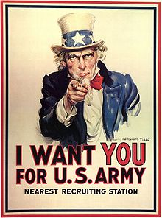
Join and Fight the Hun!
1st Infantry VTARNG
And
14th Engineers (Narrow Gauge)
2 full immersion tactical events a year
Live as they lived
Honor the memory of the forgotten war
A fun and dynamic hobby that will leave you wanting more!
Check out http://www.great-war-assoc.org/ for more information on WW I reenacting!
For more information
(802)578-3973
brett.goertemoeller@us.army.mil

